Slide 1
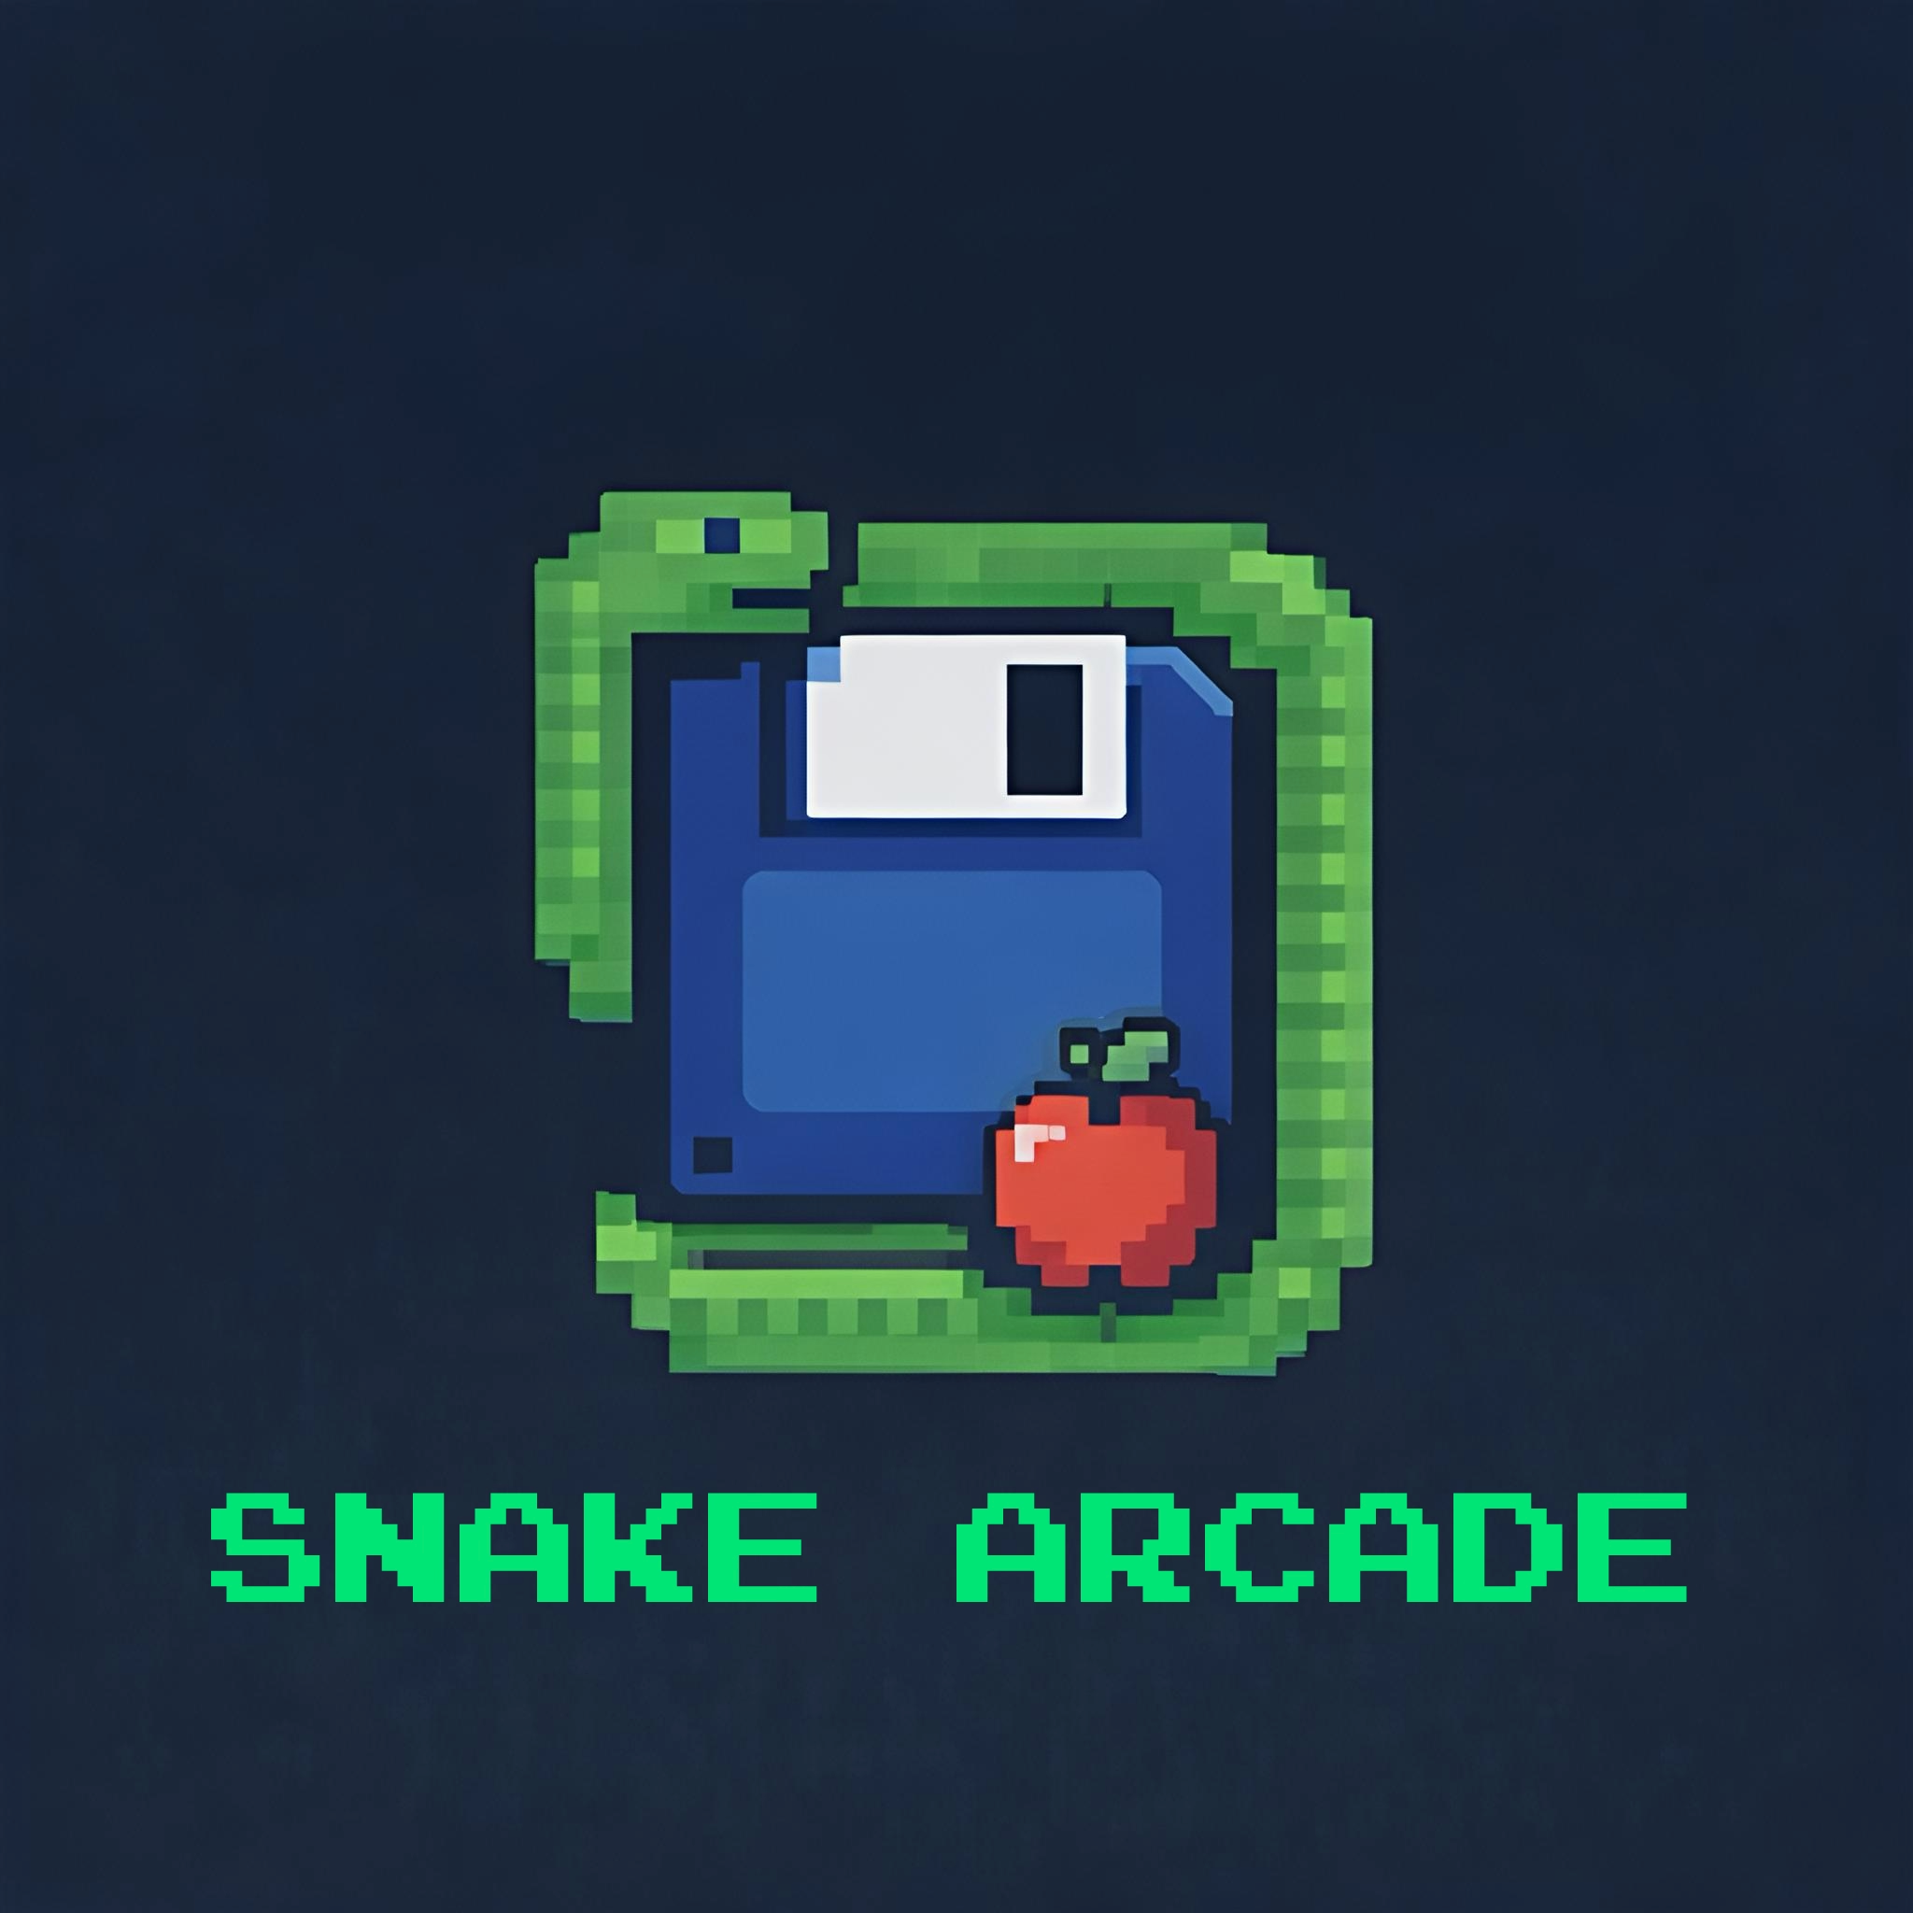

SNAKE ARCADE
SNAKE ARCADE
By daboiYoshi and snake arcade

Slide 2
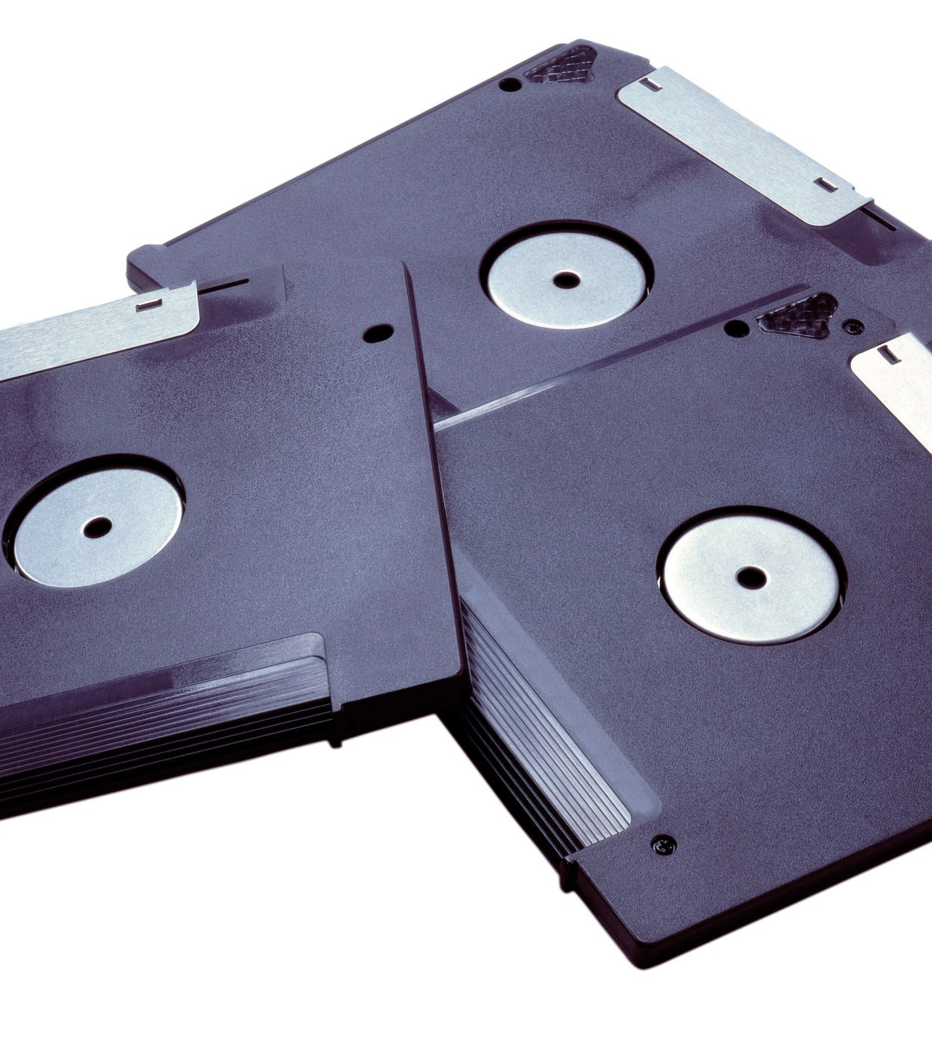
Welcome to snake arcade, newcomers!
Snake Arcade
4/3/2026
We hope you enjoy our open source resources at snake arcade!

Slide 3
Content overview
Snake Arcade
1
2
3
Our mascot, the html snake game.
We created many tools, and projects for you to use (absolutely free!)
Of course, we made terms of service so you do not abuse our tools
4
We make almost everything open-source and downloadable.

Slide 4


Our Development team (2)
Snake Arcade
CEO Executive Boss
Developer and manager
daboiYoshi
Snake Arcade
Does all the decision making of The Snake Arcade company & website.
Develops all the code & works on the website when daboiYoshi says.
info@daboiyoshi.com
info@daboiyoshi.com

Slide 5

“Boldly Moving Forward as technology evolves.”
Snake Arcade
Why we put this as our motto? Because we boldly move forward as time and technology evolves to adapt with the surrounding technological environment to invent, and create new things.

Slide 6
“We strive to get the best results here at Snake Arcade to get the most out of everything and code well and professionally.”
Snake Arcade
daboiYoshi
Chief Executive Officer Boss of Snake Arcade

Slide 7
We do try our best to make everything at snake arcade perfect, but usually, it is a hard problem to overcome.
When things go wrong, we always try our best to solve it too, and if you have any complaints for anything in our website, you can always email us.
Snake Arcade
THE PROBLEM

Slide 8

Thank you
Sources: github, youtube, google, vs code, google drive, google sites, google slides, google docs, obs, vlc, notepad++, textedit, and all open source free things!!!!!
Thank you so much for participating in our presentation.
Creators of…
daboiyoshi.com, snake arcade

